Slide 1
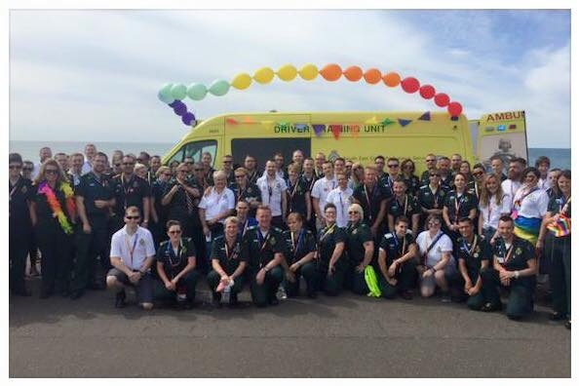
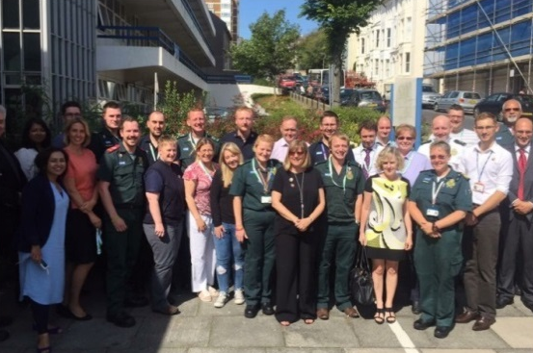
National Ambulance
LGBT Network
Supporting Lesbian, Gay,
Bisexual, Trans* staff, patients
and communities
A partnership of UK Ambulance
Services
The First National Conference
Alistair Gunn and Kirsten Willis
Co-Chairs, National Ambulance LGBT Network
5 August 2016
Notes:
[Alistair] Good morning and a warm welcome to Brighton!
My name’s Alistair and I’d like to introduce Kirsten. Both of us have been around long enough to remember several attempts at trying to set up a National Ambulance LGBT Group.
Both of us are committed to making this become a reality and are very excited about being the first elected Chairs.
House keeping information if required…
Fire alarms and exit routes
Location of toilets
Refreshments
Switch off mobile telephones
Location of smoking areas
Location of workshop ‘break-out’ rooms

Slide 2
Introduction
Why have a national network?
What has happened in the last year?
What have we achieved?
What are the next steps?
Notes:
This morning we would like to talk briefly about the development of the Network so far.
One question that I have been asked quite often, is why do we need a National Network and what is it for? We’d like to tell you exactly why we are here.
A lot of work has happened since we met here last year, and we will tell you about that. Twelve months ago, those of us here in Brighton imagined a National Network and today it is well and truly established.
We will also tell you about the next twelve months and what we would like to achieve. We would like to ask you all to contribute your ideas so that in twelve months time, we will hopefully stand here celebrating more achievements.

Slide 3
Why? Making a difference to…
patients
Do we recognise health equalities?
Older LGBT people more likely to suffer from social isolation
Increased prevalence of suicide amongst young people
Increased used of alcohol and drugs amongst LGBT people
More LGBT people worry about mental health and anxiety
Notes:
In establishing the Network we have developed Terms of Reference and concentrated on three main groups… patients, staff and communities.
I will talk about each of these in turn.
Patients are at the centre of everything we do whether we work in the 999 emergency service, patient transport or the NHS 111 service.
Although LGBT people now enjoy many equal rights, there are still areas where things aren’t equal.
There are many notable health inequalities associated with LGBT people and this slide shows a few examples.
Some of the words here are not nice ones (social isolation, suicide, mental health and anxiety) and, as ambulance people, we will be dealing with these issues, maybe without acknowledging it.
How many older people do we deal with?
How many young suicidal people have we been called to?
How many people have we picked up on a Saturday night… ‘in drink’?

Slide 4
Research and Information
Our recent health report Unhealthy Attitudes also shows that a large proportion of healthcare staff are not confidently equipped with the necessary skills to provide thorough care for LGBT people, elderly or otherwise.
Unhealthy Attitudes, Stonewall, 2015
Notes:
One area research has been critical of, is the care provided to LGBT people in later life.
Reports from Stonewall and Age UK both reveal that health services rarely acknowledge people’s sexual orientation in general, never mind that someone is LGBT.
Assumptions are made.
Obvious signs are ignored.
Probably not maliciously, but because people don’t recognise these signs or are just uniformed.
The National Network aims to address this by raising awareness of the issues and sharing good practice around the country.

Slide 5
Why? Supporting our…
staff
Are all staff valued and feel safe at work?
Bullying and harassment still happens and is not always challenged
Many LGBT staff do not declare their sexual orientation
Accessing staff networks often a challenge due to operational pressures
Many staff work remotely with little management support
Notes:
Staff are our biggest asset and we need to ensure LGBT ambulance people feels safe and valued at work.
Although many people don’t see the significance, things still aren’t equal.
We have seen many examples of staff being bullied or harassed at work, maybe not explicitly, but because cultures are not supportive and institutional homophobia is allowed.
Many bad behaviours do go unchallenged and we need to make our services understand what this means for LGBT staff.
In Yorkshire less than 1% of people declared they are LGBT on recruitment forms. If the staff from Yorkshire got together and made a list, we could easily quadruple this if not more!
So why don’t people acknowledge this?
Maybe they don’t see the significance. Maybe they are scared to do so. Whatever the reasons, this is a useful gauge of how comfortable people are and we need to challenge this.

Slide 6
Why? Being visible in our…
communities
What should our communities know about us?
We are LGBT friendly employers.
Several ‘Top 100’ employers!
Only think of the 999 emergency service. Many different career paths
Notes:
Finally, are the communities we work in. Being an LGBT friendly organisation offers many benefits.
We want to recruit great people to work in our services, and this includes LGBT people. The power of being visible will change the way people see us as potential employers.
We have all seen the photographs from various Pride events and everyone having fun representing their services.
Don’t underestimate the power of us being there. At the ones I have attended in Yorkshire I have had so many conversations with young people who aspire to Paramedics and Patient Transport Assistants. I hope some of those conversations have lead to people applying and being recruited into the service.

Slide 7
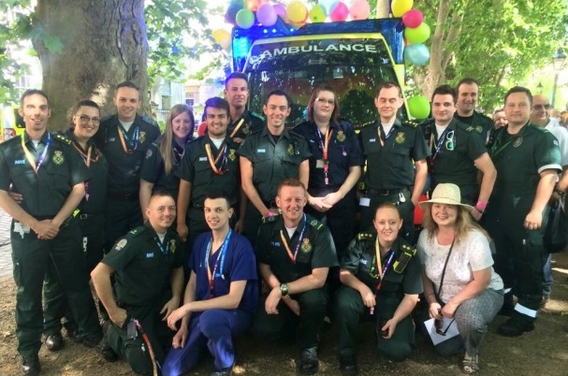
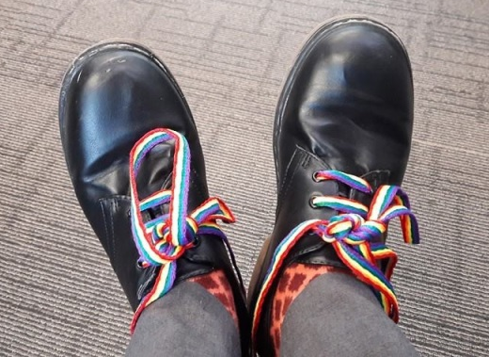
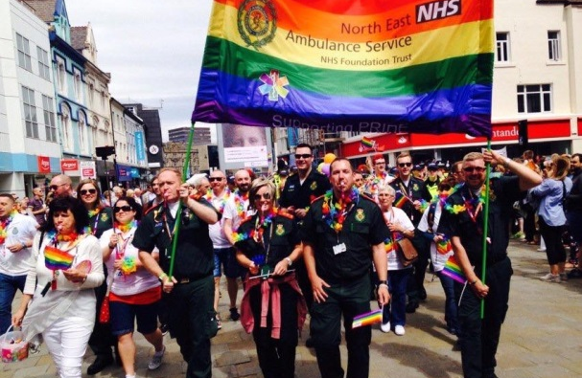
The Last Year
National LGBT Network Events
31 July 2015 | Brighton
28 October 2015 | London
10 February 2016 | Leicestershire
9 May 2016 | London
5 August 2016 | Brighton
3 November 2016 | London
9 February 2017 | Kenilworth
11 May 2017 | London
4 August 2017 | Venue TBC
Notes:
[Kirsten] Over the last year lots has happened.
As Alistair mentioned, we have seen the different events happening round the country. More people are now crossing the boundaries to celebrate Prides around the country with colleagues from other ambulance services.
Earlier this year [month?] South Central Ambulance Service celebrated IDAHO Day by encouraging staff to wear rainbow show laces. This is something we would like to encourage nationally next year!
On top of this the National Network has met three times and held three very productive meetings.
Several smaller ‘task and finish’ groups have met to develop the priority areas. One group has worked on trans* guidance, one on developing the brand and identity, and another organised today’s conference.

Slide 8
Establishing Priorities
Develop the national brand and identity
Commitment to resource and support the national group
Develop transgender guidance to support staff and patients
Plan and deliver annual National Ambulance LGBT conference
Notes:
In the first meeting we established four priority areas to work on.
Hopefully you have all seen, and like, the new identity. It is shamelessly brash and has been created to get noticed. We hope you like it and you’ll certainly see more of this in the coming months.
In the background we have been rallying support from each Trust to provide support for people’s involvement in the working groups, and also financial support to make the National Network sustainable.
If you hadn’t noticed, funding in the NHS is a little tight at the moment! That is why we have to be very clear about the purpose of the Network and what benefits it will bring, so we have a strong case for support.
Most people will probably feel comfortable with ‘LGB’, but how many people feel informed and equipped enough to support the ‘T’?
We recognised early on that if the T is included – and we are delighted it is – that we needed to collect guidance, policy and good practice and inform ourselves.
Finally, we wanted a National Conference… and you’re all here so we must have got that one right!

Slide 9
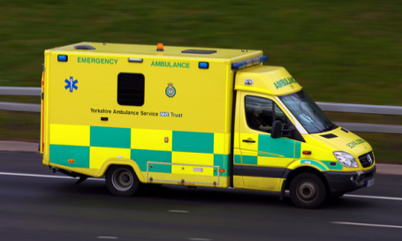
Name and Identity
National Ambulance LGBT Network
Approved!
Approved!
Approved!
Notes:
Creating the identity is a little more complex than you may think.
Even choosing a name presented a lot of debate, but thanks to a poll and good response from people across the country, we have unanimously chosen National Ambulance LGBT Network as the name.
We think it’s a great name too. Not only is a body in its own right, but brings together the regional LGBT Networks from each partner Trust.
We have a Terms of Reference and reporting lines. It’s maybe not something you would consider, but we are supported by the National Ambulance Diversity Forum and have links to the Ambulance Chief Executives Group.
We also have a symbol and the ‘rainbow star-of-life’ was chosen for its simplicity and effectiveness. It combined the symbol of pre-hospital emergency care with the LGBT symbol of identity.

Slide 10
Supporting the ‘T’
LGB
LGB&T
LGBT
Notes:
We have debated the inclusion of ‘T’ as a National Network, and are sure each regional network has also had similar debates.
Interestingly this was not about whether this should be included for preference, but rather could our networks provide the right level of support of a trans* member of staff approached it?
This has been addressed full on and we have collected a large number of resources from around the country to offer support and share good practice.
We have also seen the development of bespoke packs of information and training to support teams within the ambulance service.
We hope this will all be available online shortly as we develop our web based resource.

Slide 11
Social Media and Online
Twitter:
@NatAmbLGBTUK
Facebook:
Gay Ambulance Association
Closed Group
Coming Soon!
www.ambulanceLGBT.org
Notes:
Talking of t’ internet..!
Hopefully you are all aware of the Twitter feed and Facebook page. We hope you will all be sharing your experiences and pictures though social media over the next two days.
Just remember, we have a duty to ensure we don’t do any reputational damage to our services too!
We have now purchased a domain name so we can have a national web presence.
Sadly, developing a website is not a quick job and we couldn’t have this ready for today. If you type in this address you will be directed to a holding page.
We hope the first part of the site will be going live in September however, and will continue to develop over the next twelve months.
Keep an eye on this, and if you’d like to help build it, let us know!

Slide 12
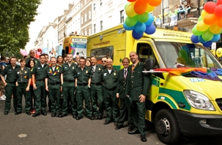
The Next Year
EMERGENCY AMBULANCE
Yorkshire Ambulance Service NHS Trust
Notes:
[Alistair] So what is in store for the next year?
There is still a lot of work to do to get the Network visible and recognised in all our Trusts. This work is ongoing and we hope next year we can confirm every Trust is on board and that we have secured an autonomous budget.
One of the next priorities is to get the web based resource up and running. This means you will all be able to access information and see what events and activities are happening around the country.
Around the country we have seen numerous areas of good practice. We want to ensure this is shared, and hopefully work toward all patients and staff, wherever they are in the country, receive great care and support.
We want to start campaigning and making sure patients view the service as ‘LGBT friendly’. A pilot is going live in Yorkshire this autumn and we hope this will roll around the country.
Of course, the Pride events are still happening and it is important we continue to have visibility at these events and also embrace the other opportunities… Gay History Month, IDAHO Day, Trans* Awareness Day to name a few.

Slide 13
Your Ideas Count
Develop a national website and resource base
Continue to gain visibility in each Ambulance Trust
Develop resources where there are gaps
Continue to take part in Pride events
Get the ‘rainbow star-of-life’ on every ambulance
Prepare the second National Conference
Your idea…
Your idea…
Your idea…
Add your brick to the wall!
Your idea…
Your idea…
Notes:
Today is also about collecting your ideas and priorities.
In your packs you will see a sheet printed as a brick.
We would like you to put one idea that you think the National Network should focus on in the next twelve months. Please contribute your ideas. More ‘bricks’ are available if you need them.
Individually one idea does not look like a lot, but when we collate eighty ideas and build our ‘ideas wall’, we can soon see a different picture. This will help the core group identify its priorities for the coming months.

Slide 14
Finally…
Enjoy Your Day!
Alistair Gunn Yorkshire Ambulance Service alistair.gunn@yas.nhs.uk
Kirsten Willis South Central Ambulance Service kirsten.willis@scas.nhs.uk
Ben Sargent North East Ambulance Service ben.sargent@neas.nhs.uk
Notes:
Finally, we hope you enjoy today.
We have some great speakers and workshops for you and please make the most of the experience.
As well as this, several of our sponsors are here and we would encourage you to talk to them during the breaks and at lunchtime.
Without our sponsor’s support, today would not look like it does so a huge thank you to them.
We would also like to say a few up front thank yous at this point… more to come later.
Dave Macklin and Geraint Davies have been the Chairs of the group until we were elected back in May. We know both have been passionate about getting this Network established. In taking over as Chairs we hope to do you proud and take the Network to the next level.
Thank you and enjoy your day!

Slide 15
Thank you to our sponsors
Today’s conference is sponsored by:
National Ambulance LGBT Network
Supporting Lesbian, Gay, Bisexual, Trans* staff, patients and communities

